Slide 1
APERIO
Max Diamond, Yash Sharma, Kevin Sheng, and Armaan Thapar

Slide 2
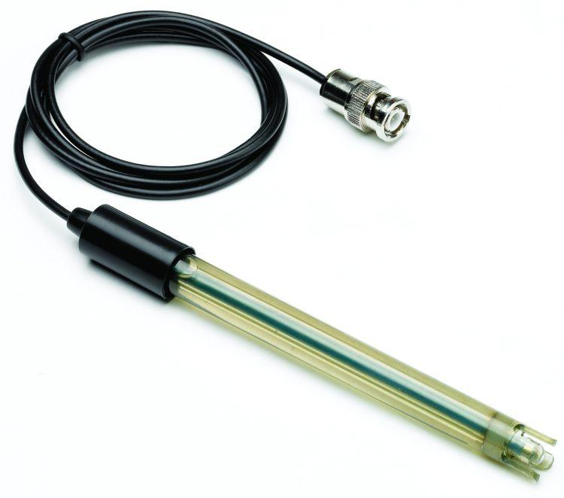
Our Goals
-Efficient Design
-Cost Effectiveness
-Implementing Sensors

Slide 3
Prototype
Current Design
-Measure Flow
-Measure Turbidity
-Finished Design
-Aesthetics

Slide 4
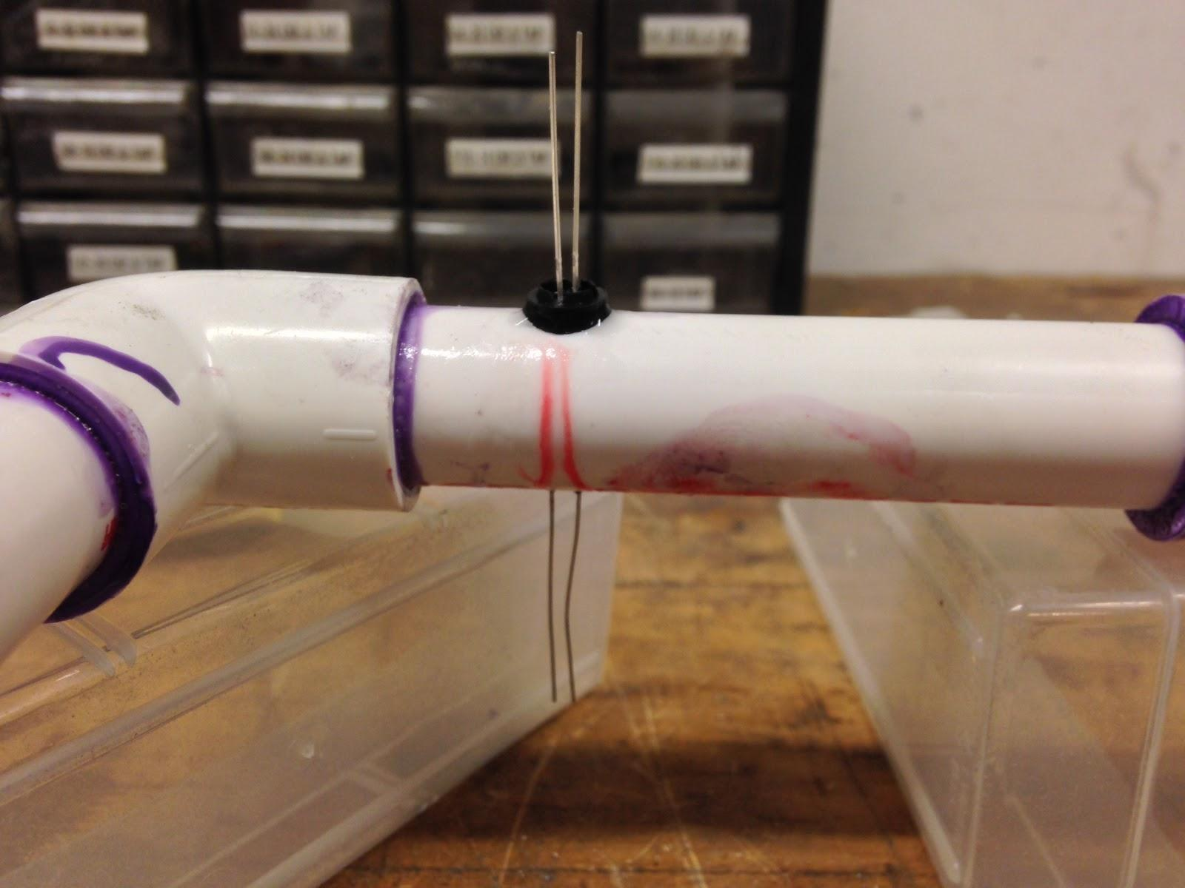
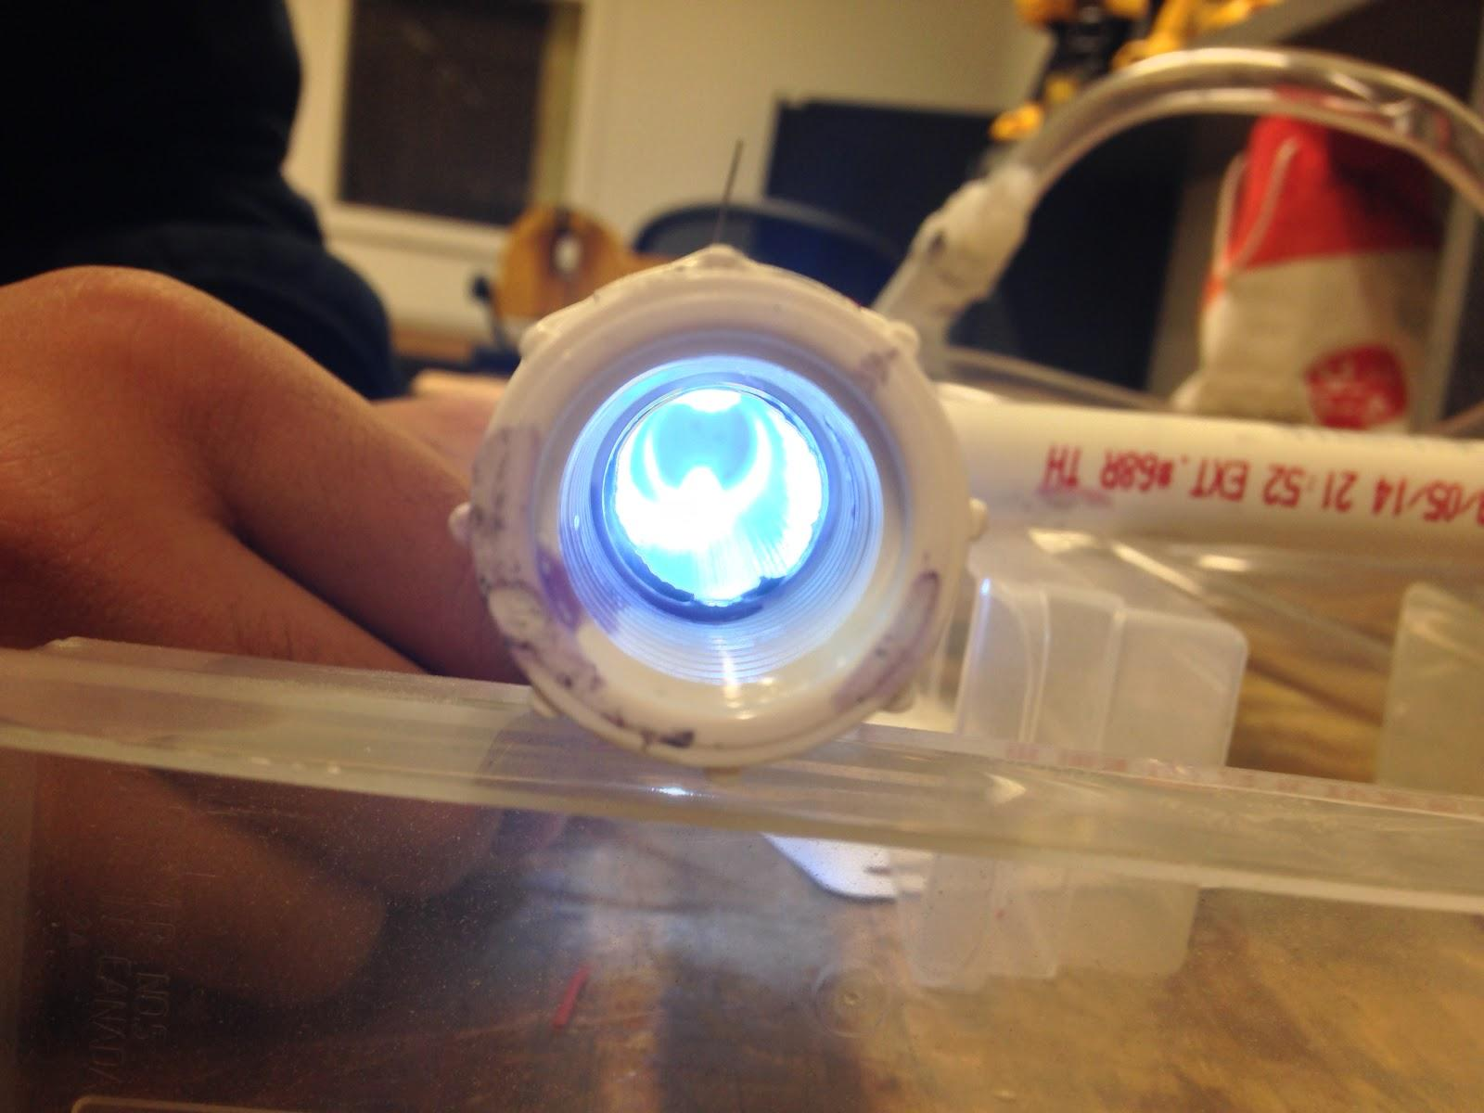

Slide 5
Target Audience
-Income
-Age group
-Mindset
-Location

Slide 6
Beta
Created Prototype
Created Online Content
Facebook
Google+
Website
Obtained Email List for continued communication
Survey

Slide 7
What we learned
There is a genuine interest in Aperio
Predicated on communication abilities
Most popular with millennials
Affected by method of information distribution however

Slide 8
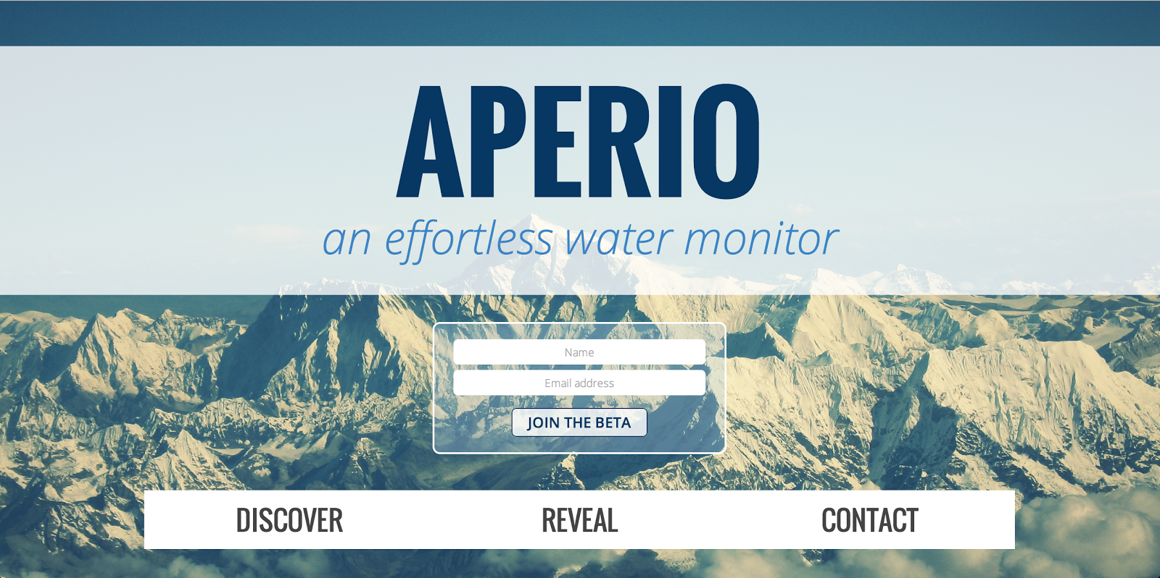
Marketing
-Reaching out
-Raise money
-Second Prototype
-Mass Production

